Slide 1
District-Wide Professional Development
Friday, October 14, 2016
Forest Park Community College – Mildred Bastian Theatre
8:00 a.m. – 11:00 a.m.
Meeting Facilitator: Dr. Thomas LaRosa, School Psychologist

Slide 2
Theoretical Foundations
Numerous structural models of intelligence
Wechsler considers various models (one of which is Cattell-Horn-Carroll [CHC])
Example: An expansion of Vernon’s hierarchical model produces superior CFA results in some studies (Johnson & Bouchard, 2005a; 2005b; Johnson, te Nijenhuis, & Bouchard, 2007)
Wechsler model accounts for important aspects of cognitive ability that these models converge upon
CHC theory is still evolving
CHC theory does not account for important lessons we learn from working memory models (Multicomponent model, Baddeley, 2000, 2002, 2012; Embedded-processes model, Cowan, 1988; Towse & Cowan, 2005)
Neurodevelopmental models
Clinical utility (#1)
Notes:
Numerous structural models of intelligence, Wechsler considers various models, of which CHC is one
Example: Numerous publications by Wendy Johnson’s group show more support for Vernon’s hierarchical theory (see chapter 2 in the Technical and Interpretive Manual)
Wechsler model accounts for important aspects of cognitive ability that these models converge upon
CHC theory is still evolving
(Schneider & McGrew, 2012 CHC chapter in Contemporary Intellectual Assessment)
CHC theory does not account for important lessons we learn from working memory models (chapter 2 Tech and Interp Manual)
Baddeley’s multicomponent model
Cowan’s embedded processes model
Wechslers select subtests based upon clinical utility, not just theory

Slide 3
1. Update Theoretical Foundations
Increase breadth of construct coverage by developing:
visual spatial subtest
fluid reasoning subtest
visual working memory subtest
subtests to measure additional processes related to learning (naming facility, associative memory)
to measure additional cognitive processes relevant to learning disabilities
Notes:
In terms of updating the theoretical foundations of the measure, the team looked at research regarding Contemporary structural intelligence models (CHC-based research, for ex)
Current, widely accepted structural intelligence models are based on comprehensive factor-analytic results. These studies provide overwhelming evidence for general intelligence at the top of a hierarchical model and for various related and distinguishable broad abilities at the level beneath. In some models, the specific abilities are each composed of various narrow abilities at the lowest level (Carroll, 1993, 2012; Horn & Blankson, 2012; Johnson et al., 2004; Johnson & Bouchard, 2005a, 2005b; Johnson et al., 2007; Salthouse, 2004). Although evidence from structural models does not identically converge, most indicate that verbal comprehension, visual spatial, fluid reasoning, working memory, and processing speed abilities are important components (Carroll, 1993, 2012; Horn & Blankson, 2012; Johnson et al., 2007; Salthouse, 2004). The Wechsler intelligence scales (Wechsler, 1991, 1997, 2002, 2003, 2008, 2012) have evolved in response, adding new measures of visual spatial ability, fluid reasoning, working memory, and processing speed. The WISC–V continues this work by providing new measures of visual spatial ability, fluid reasoning, and working memory; offering separate visual spatial and fluid reasoning composites; and improving upon the measure of verbal comprehension and processing speed while continuing to offer composite scores for each.
Additionally, Neurodevelopmental and neurocognitive research (Lurian traditions, process approaches based on the work of Edith Kaplan, research pertaining to impacts of brain trauma on functioning/development – i.e., TBI )
Working memory models and research (Baddley’s work and others)
Current Research links both general intelligence and specific cognitive
abilities measured by the WISC-V to structural and functional aspects of brain development.
We recognize that one of the areas in which the WISC is used frequently is in Clinical neuropsychological assessment. During these assessments, clinicians use cognitive testing to determine
impairment or change after an injury or an illness, specifically in relation to particular brain
structures or pathways. Several important cognitive constructs measured on the WISC-V may
be utilized to generate hypotheses about neuropsychological processing deficits or interpreted
from a neurodevelopmental perspective (Maricle & Avirett, 2012; McCloskey, Whitaker,
Murphy, & Rogers, 2012; Miller & Maricle, 2012).
Based on the rate of progress in the field of brain imaging, psychologists and educators alike should re-examine their current knowledge about intelligence to include relevant literature on the neural basis of intelligence (Haier & Jung, 2008).

Slide 4
2. Increase Developmental Appropriateness
Instructions
Reduce vocabulary level, verbosity
ceiling items on Similarities
“Advantages” and other high vocabulary level of items on Comprehension
Demonstrate, practice, and teach the task
Replace outdated art and items with more current and relevant
Notes:
particular, attention was given to the instructions and item phrasing, scoring criteria, and time-bonus points
We really do listen when you say that you have concerns about the vocabulary level associated with the directions or question stems for some items - for example, (CLICK) the use of the word advantges on comp questions.
Instructions were tested repeatedly with children aged 4:6–5:11 (younger than the youngest children in the WISC–V age range), as well as children with intellectual disabilities, to ensure children with developmental delays or low intellectual ability would understand task demands. During development, children were questioned about their strategies and responses to ensure that the instructions engaged the intended cognitive processes. Examiners were also surveyed about aspects of instructional clarity.
verbatim instructions are succinct, and active demonstration and practice are used to supplement verbal instructions wherever possible because many children who are evaluated with the WISC–V have issues with attention and comprehension. During early pilot testing, instructions were checked for brevity, and several revisions were made.

Slide 5
3. Increase User Friendliness
Reduce testing time
5 primary index scores: 65 minutes mean (10 minutes shorter than WISC-V mean)
FSIQ: 48 minutes mean (27 minutes shorter than WISC-V mean)
Shorter discontinue rules, fewer items, selecting subtests with briefer admin time to contribute to these scores
Notes:
Total of 3 stim books in pnp edition. Two Stimulus Books contain the stimuli associated with the primary and secondary subtests that are necessary to derive the primary index scores, FSIQ, and the ancillary index scores. The third Stimulus Book contains the stimuli associated with the complementary subtests that are necessary to derive the complementary index scores NSI, STI, and SRI for special clinical purposes.
Strove for improved durability of all materials
While practitioners make the need for brief testing time clear (Camara, Nathan, & Puente, 2000), they also expect intellectual ability assessments to adequately measure a number of important cognitive ability domains. Thus, substantial efforts were made during the WISC–V development to achieve the briefest testing time possible AND also offer greater construct coverage and flexibility, and more composite scores.
Briefer testing time accomplished by- shortening subtest instructions, the number of items administered is held to a minimum by reducing the overall number of items and modifying discontinue rules
For example, the WISC–IV discontinue rule for Similarities was 5 consecutive scores of 0 but is reduced to 3 consecutive scores of 0 on the WISC–V. Refer to Chapter 3 of the Tech manual for more details about the empirical studies conducted to determine final discontinue rules.

Slide 6
New Subtests to Extend Content Coverage and Clinical Utility
Visual Puzzles: Visual Spatial ability; Allows separation of WISC–IV Perceptual Reasoning Index into Visual Spatial Index and Fluid Reasoning Index
Figure Weights: Quantitative fluid reasoning
Picture Span: Visual working memory
Naming Speed Literacy Naming Speed QuantityExpands Patterns of Strengths and Weaknesses (PSW) analysis for specific learning disability (SLD) identification or to provide further information about rapid automatized naming if the need is present
Immediate Symbol Translation Delayed Symbol Translation Recognition Symbol TranslationExpands PSW analysis for SLD identification or to provide further information about paired associate learning (visual-verbal associative memory) if the need is present

Slide 7
4. Improve Psychometric Properties
Items and scoring rules
Norms and norming method
Maintain or improve reliability
Floors and ceilings
Reevaluate item bias
Iterative psychometric analyses
Qualitative reviews by experts
Significance level options for critical values
Notes:
As noted, one of the goals is always how we can improve some of the psychometric properties of our scales. We recognize the importance of this goal given the high-stakes nature of these kinds of assessments – not only do you need a tool that you can trust, the children that you are evaluating, and their families deserve it.
So, these are some of the examples of how we address this goal in the development of the WISC-V.
WISC–V normative data were established using a sample collected from April 2013 to March 2014. Sample stratified on key demographic variables (i.e., age, sex, race/ethnicity, parent education level, and geographic region) according to the October 2012 U.S. census data
Retest data are reported for all ages and for three separate age groups (6–7, 8–9, 10–11, 12–13, and 14–16). Evidence of convergent and discriminant validity is provided by correlational studies with the following instruments: WISC–IV, WPPSI–IV, WAIS–IV, Kaufman Assessment Battery for Children–Second Edition (KABC–II; Kaufman & Kaufman, 2004a), Kaufman Test of Educational Achievement–Third Edition (KTEA–3; Kaufman & Kaufman, 2014); Wechsler Individual Achievement Test–Third Edition (WIAT–III; Pearson, 2009), Vineland Adaptive Behavior Scales–Second Edition (Vineland–II; Sparrow, Cicchetti, & Balla, 2005), and the parent rating scales from the Behavior Assessment System for Children–Second Edition (BASC–2 PRS; Reynolds & Kamphaus, 2004).
GT will have GRS
Mild & Mod ID and BIF will have Vineland II
RD, MD, WD, and NVLD will have WIAT-III
ADHD Inattentive: Brown ADD
NVLD, AUT, and ASP will have BASC-2
NVLD criteria:
To be included, should be recruited from a site that serves this population
To adequately measure this range of ability, items of both low and high difficulty were added to retained subtests as necessary. The improved subtest floors and ceilings allow for better discrimination among children performing at the extreme ranges of cognitive ability
Contemporary methodologies for testing item bias were used for item selection. Problematic items were deleted on the basis of formal expert review of items and empirical data from statistical bias analyses. Experts in cross-cultural research and/or intelligence testing conducted formal reviews on four occasions. During the initial stages of development, all subtests and items were reviewed by internal and external reviewers for potential bias, cultural obsolescence, content relevance, and clinical utility. During the pilot stage, tryout stage, and standardization stage, content and bias experts reviewed the items and identified those that were potentially problematic. Along with these reviews, empirical data from bias analyses were used to assist in the item decision process. In order to ensure adequate sample sizes for bias analysis across racial/ethnic groups, an oversample of 54 African American and 54 Hispanic children was collected during the tryout stage.

Slide 8
5. Enhance Clinical Utility
Provide subtests to measure cognitive processes known to be clinically sensitive to learning disabilities to enhance pattern of strengths and weaknesses (PSW) approach to learning disability evaluation
Naming Speed Literacy and Naming Speed Quantity
Immediate, Delayed, and Recognition Symbol Translation
Provide PSW link in joint software with WIAT-III and with KTEA-3 (and CELF-5 forthcoming)
Notes:
Finally, a test can’t just be easy and psychometrically sound – it also has to provide you with useful information to help children, caregivers, and teachers.
We recognize that many clinicians and states are beginning to see that RTI does not explain why a child does not respond to instruction, and want to do more to identify the strengths and needs of students. We believe that the updates to the WISC-V in this regard are extremely important in helping clinicians explain to parents and teachers why a child might experience difficulty learning.
One of the things that we are most excited about is that for the first time ever, the WISC will be linked with the KTEA-3 (not just the WIAT). The correlational studies with both WIAT-III and KTEA-III will permit examination of discrepancies and patterns of strengths and weaknesses (PSW) analysis with both measures! And, integrated scoring reports via Q-global (or Q-interactive if you are conducting digital administrations) will also be available for these measures.
In addition to providing the traditional ability-achievement discrepancy analysis, data from the WISC–V/KTEA–3 and the WISC–V/WIAT–III linking studies may be used to examine the child’s pattern of strengths and weaknesses as part of an evaluation to identify specific learning disabilities.
The addition of visual working memory enhances the scale’s clinical utility due to the domain-specific differential sensitivity of auditory and visual working memory tasks to a wide variety of clinical conditions.

Slide 9
Enhance Clinical Utility (cont’d)
Add special group studies based on use
Borderline Intellectual Functioning
English Language Learners
Notes:
12 special group studies
Intellectually Gifted, Intellectual Disability-Mild Severity, Intellectual Disability-Moderate Severity, Borderline Intellectual Functioning, Specific Learning Disorder–Reading, Specific Learning Disorder–Reading and Written Expression, Specific Learning Disorder–Mathematics, Attention-Deficit/Hyperactivity Disorder, Disruptive Behavior, English Language Learners, Autism Spectrum Disorder With Language Impairment, and Autism Spectrum Disorder Without Language Impairment. Children from some special groups participated in the concurrent validity studies with other measures.
As you can see, there were some changes in the special group studies reported in W5. When asked, clinicians reported that they did not find the special group studies for the ELD and RELD categories very useful.
For the WISC-V Integrated, we may get small groups to report data on ELD and RELD.

Slide 10
CFA Model
Similarities
Vocabulary
5 Factor
Arithmetic on Fluid Reasoning, Crossloading on WM and VC
Verbal
Comprehension
Information
Comprehension
Visual
Spatial
Block Design
Visual Puzzles
Matrix Reasoning
Full Scale
Fluid
Reasoning
Figure Weights
Picture Concepts
Arithmetic
Working
Memory
Digit Span
Picture Span
Letter-Number Sq
Processing
Speed
Coding
Symbol Search
Cancellation

Slide 11
Subtest Types and Categories
Subtest | Score Type | Category
Block Design | Scaled | Primary (FSIQ)
Similarities | Scaled | Primary (FSIQ)
Matrix Reasoning | Scaled | Primary (FSIQ)
Digit Span | Scaled | Primary (FSIQ)
Coding | Scaled | Primary (FSIQ)
Vocabulary | Scaled | Primary (FSIQ)
Figure Weights | Scaled | Primary (FSIQ)
Visual Puzzles | Scaled | Primary
Picture Span | Scaled | Primary
Symbol Search | Scaled | Primary

Slide 12
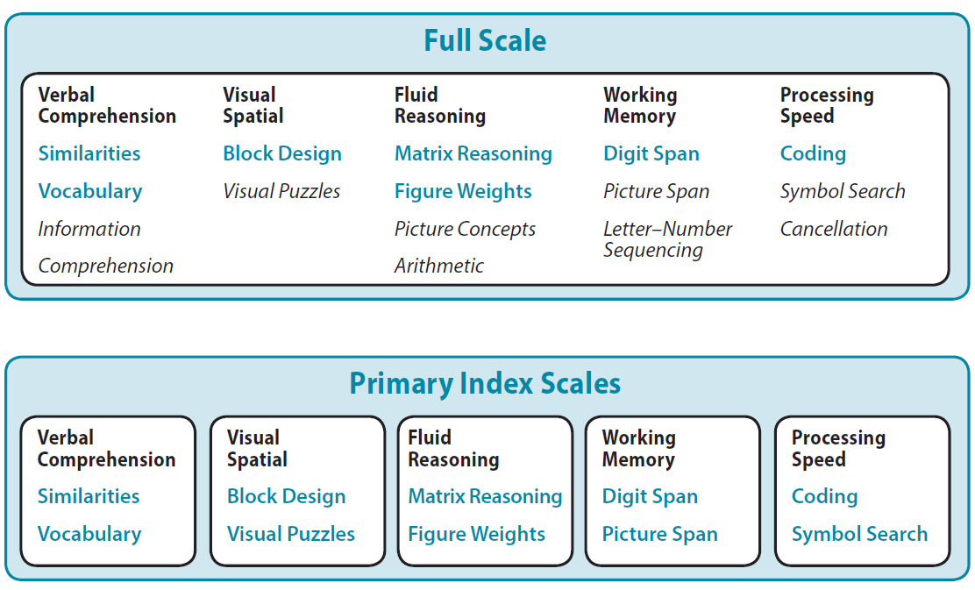
Full Scale (FSIQ)
Headline placed here
Text here…
Notes:
Provide a comprehensive estimate of global ability

Slide 13
Enhance Clinical Utility (cont’d)
Ancillary Index Scores
Quantitative Reasoning Index (QRI)
Auditory Working Memory Index (AWMI)
Nonverbal Index (NVI)
General Ability Index (GAI)
Cognitive Proficiency Index (CPI)
Notes:
These are the Ancillary Scores that are likely. However, the team will evaluate based on standardization data.
GAI and CPI will be re-evaluated as well based on factor structure
GAI = VCI + PRI in the past
CPI = WMI + PSI
There are also some Ancillary scores that are also still being evaluated – some a bit further out than others, given that they would involve the WISC-V Integrated and some of the subtests that will be available only in a digital format). While we are not yet sure of the viability of some of these additional ancillary scores we will evaluate them.
For example, a Quantitative Reasoning and a 2 subtest, complex verbal expression (VC, CO) Ancillary Index is being evaluated to determine feasibility and clinical usefulness. Other ancillary involving the WISC-V Integrated, for example will be evaluated as the five evolves.
To the extent possible, we will Leverage digital version to provide more clinical information uniquely derived in and suited for that modality
The NVI offers a more appropriate estimate of overall ability for children with substantial expressive language delays or other clinical conditions associated with expressive verbal difficulties (e.g., autism spectrum disorders). The NVI also provides a useful estimate of overall ability for children who are deaf or hard of hearing, or children who are English language learners. The NVI samples from more than one cognitive domain and therefore provides a more robust estimate of overall ability than primary index scores such as the VSI or FRI. The NVI also may be used to contrast ability with achievement on the KTEA–3 and the WIAT–III using the appropriate tables in Appendix B of this manual.
QRI, GAI, CPI, NSI, STI, and SRI. These ancillary index scores are discussed extensively in Chapter 6. In general, they are designed for special clinical situations and provide more scores to answer specific referral questions.

Slide 14
Subtest Types and Categories
Subtest | Score Type | Category
Information | Scaled | Secondary
Picture Concepts | Scaled | Secondary
Letter-Number Seq | Scaled | Secondary
Cancellation | Scaled | Secondary
Comprehension | Scaled | Secondary
Arithmetic | Scaled | Secondary

Slide 15
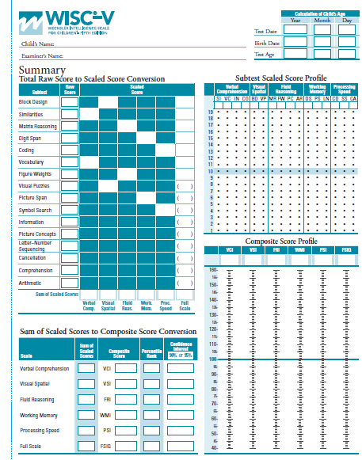
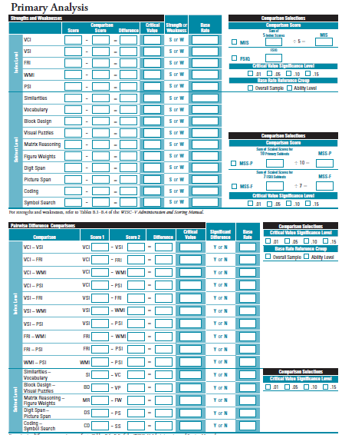
Summary Page (Derive Subtest Scaled Scores, FSIQ, Primary Index Scores)
Primary Analysis Page (Mean and Pairwise Comparisons for Primary Index Scores & Primary Subtests)

Slide 17
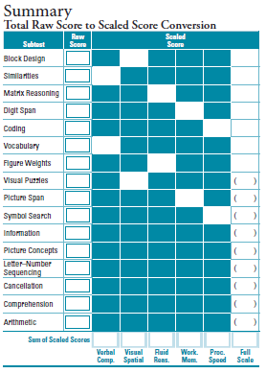
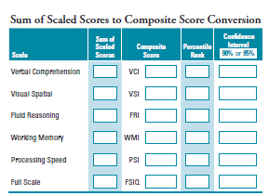

Slide 18
Primary Index Scores
Headline placed here
Text here…
VCI
VSI
FRI
WMI
PSI
Perceptual Reasoning Index (PRI)
Replaced
Notes:
Provide more targeted measures of various types of ability; Recommended as the primary level of interpretation
PRI split into the VSI and the FRI: clearer communication of results to parents and teachers
WMI: an important component of overall cognitive functioning as these skills support the capacity for information retrieval, reasoning, problem solving, and application of knowledge
PSI: significant correlation between processing speed and cognitive ability and the sensitivity of processing speed measures to clinical conditions, such as ADHD, learning disorders, and autism spectrum disorders

Slide 19
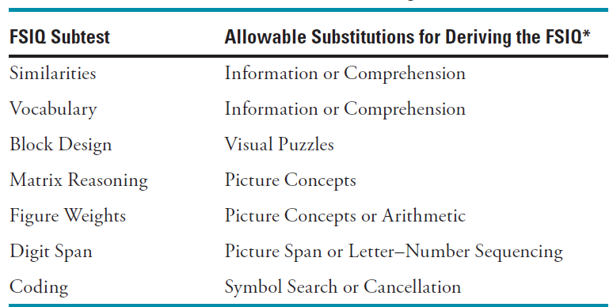
Substitution and Proration = No More “Core” and “Supplemental”
Only one sub OR pro on FSIQ
No subs or pros on any index score
Less necessary with the expanded composite score options
Notes:
Only one substitution OR proration on FSIQ
Much less necessary with all the composite score options now available
Simplifies questions about edge cases
No substitution or proration on any index score

Slide 20
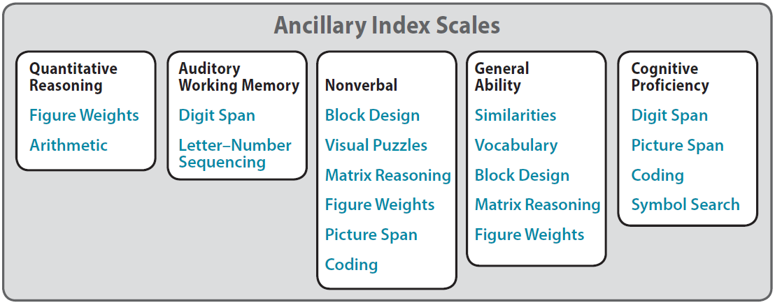
Ancillary Index Scores
QRI
AWMI
NVI
GAI
CPI
On Record Form Analysis Pages and in Administration and Scoring Manual Supplement: Optional carry-along
Notes:
QRI:
closely related to general intelligence
assists with more accurately predicting both reading and mathematics achievement scores, creativity, future academic success, success in gifted programs, professional examination performance, and future educational attainment.
can help tailor instruction and intervention to a student’s strength
may be of special interest if it is suspected that a child has a specific learning disability in mathematics, as quantitative reasoning may be a particular weakness and a pertinent target for intervention
AWMI
Purer measure of auditory working memory, relative to the WMI, provides somewhat different information.
Many popular working memory models conceptualize domain-specific systems of working memory.
multicomponent model
domain-specific storage components appear to be distinct in children in the WISC–V age range, and show differential sensitivity to various clinical conditions
NVI
Measure of general intellectual ability that minimizes expressive language demands for children with special circumstances (e.g., English language learners, DHH) or clinical needs (e.g., autism spectrum disorders with language impairment)
Some DSM–5 conditions specify that in certain situations a nonverbal measure of ability is necessary in order to establish that a child’s symptoms meet diagnostic criteria:
if a diagnosis of intellectual disability is already established and a comorbid diagnosis of language disorder is under consideration.
if language impairment AND being considered for a diagnosis of intellectual disability, AND cannot obtain valid scores on the Verbal Comprehension subtests that contribute to the FSIQ, the Nonverbal Index is a useful alternative (Raiford & Coalson, 2014).
GAI
Because WM and PS subtests contribute to the FSIQ, lower FSIQ scores may be obtained by children with neurodevelopmental disorders that are associated with difficulties in working memory and processing speed, such as learning disabilities, ADHD, language disorders, or autism spectrum disorders
In these situations, the lower FSIQ score may mask meaningful differences between general cognitive ability (represented by the FSIQ) and other cognitive functions (e.g., achievement and memory).
The GAI provides the practitioner with an estimate of general intellectual ability that, relative to the FSIQ, is less sensitive to the influence of working memory and processing speed difficulties because it excludes those subtests.
Some have advocated use of the GAI in placement decisions for gifted and talented or similar programs; NAGC position paper recommends use of the GAI in gifted evaluations.
CPI
estimate of efficiency with which information is processed in the service of learning, problem solving, and higher order reasoning.
Working memory and processing speed are related in that working memory involves identification, registration, and manipulation of information in short-term memory storage, and processing speed relates to rapid identification and registration of information in short-term memory for decision making.
The CPI is most informative together with its counterpart, the GAI.

Slide 22
AWMI Measures
Memory Span Rote Memory Attention and Concentration
Immediate Auditory Memory Working Memory Numerical Ability
Auditory Sequential Processing Planning Ability Mental Manipulation

Slide 23
Nonverbal Index
Useful when the examinee has obvious verbal difficulties (ELL)
Language Impairment
ASD with language impairment
More emphasis on reasoning using visual-spatial processes than FSIQ.

Slide 24
Nonverbal Index Measures
High NVI Scores
Well-developed general intellectual functioning for visually presented stimuli.
Low NVI Scores
• Slow processing speed.
• Low working memory.
• Low abstract and conceptual reasoning abilities.
• Low spatial reasoning.
• General low intellectual ability

Slide 25
General Ability Index
The GAI provides an estimate of general intellectual ability that is less reliant on working memory and processing speed than the FSIQ.

Slide 26
General Ability Index
High GAI Scores
Low GAI Scores
Verbal problem-solving.
Visual-perceptual and spatial reasoning.
Abstract, conceptual reasoning.
General low intellectual ability.
Language deficits
Visual-spatial processing difficulties.
Poor reasoning skills.

Slide 27
Cognitive Proficiency Index
The CPI provides an estimate of the efficiency with which information is processed in the service of learning, problem solving, and higher order reasoning.

Slide 28
CPI
High CPI Scores
Low CPI Scores
High degree of cognitive efficiency for manipulating and rapidly processing information.
Visual or auditory processing deficits.
Inattention.
Distractibility.
Visuo-motor difficulties.
Limited working memory storage or mental manipulation capacity.
Generally low cognitive ability.

Slide 29
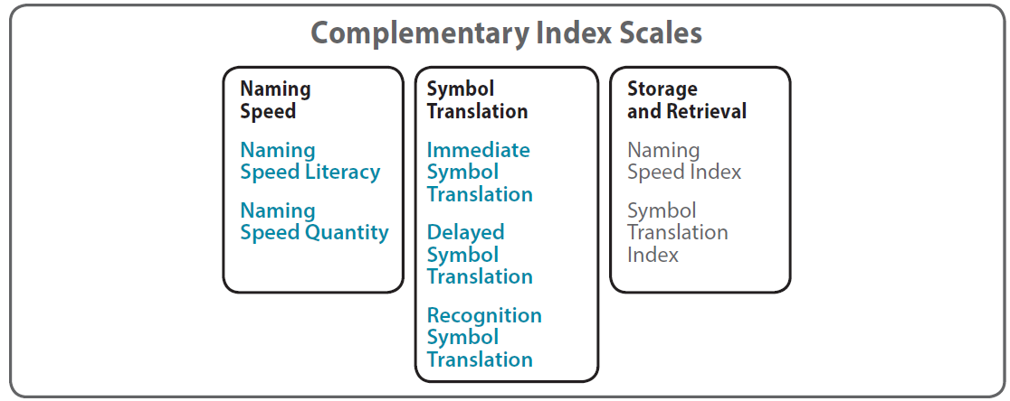
Complementary Index Scores
Headline placed here
Text here…
NSI
STI
SRI
On Record Form Analysis Pages and in
Administration and Scoring Manual Supplement: Optional carry-along
Notes:
Complementary index scores
of particular interest to those using cross-battery approaches
NSI
broad estimate of automaticity of basic naming ability drawn from a variety of tasks
developed to enhance the assessment of children with suspected learning disabilities
not designed as measures of intellectual functioning
closely associated with reading and spelling skill development, with reading achievement, and with a number of variables related to reading and spelling, and have shown sensitivity to specific reading disability in reading
associated with mathematics skills and achievement, and show sensitivity to specific learning disability in mathematics
sensitive to a wide variety of other neurodevelopmental conditions such as ADHD, language disorders, autism spectrum disorders
STI
broad estimate of visual-verbal associative memory drawn from a variety of conditions.
reading decoding skills, word reading accuracy and fluency, text reading, and reading comprehension
sensitive to dyslexia
related to math calculation skills and math reasoning
developed to enhance the assessment of individuals suspected of having learning problems or declarative memory impairment.
not developed as measures of intellectual ability
SRI
based on the sum of standard scores for the NSI and the STI.
broad estimate of long-term storage and retrieval accuracy and fluency derived from a variety of tasks designed to assess cognitive processes that are associated with reading, mathematics, and writing skills, and have shown sensitivity to specific learning disabilities and other clinical conditions.
Long-term storage and retrieval, as a broad construct, is related to reading math and writing skills

Slide 30
Descriptive Classifications
NEW
Composite Score Range | WISC–V Descriptive Classification | Traditional Descriptive Classification (“Old”)
130 and above | Extremely High | Very Superior
120–129 | Very High | Superior
110–119 | High Average | High Average
90–109 | Average | Average
80–89 | Low Average | Low Average
70–79 | Very Low | Borderline
69 and below | Extremely Low | Extremely Low
Notes:
Changed due to concerns over term “borderline” what does it mean?
Terms were not parallel
Hot topic at NASP, good talking point for school psychs
Can select this classification system in software for WIAT3 and KTEA3 consistency

Slide 31
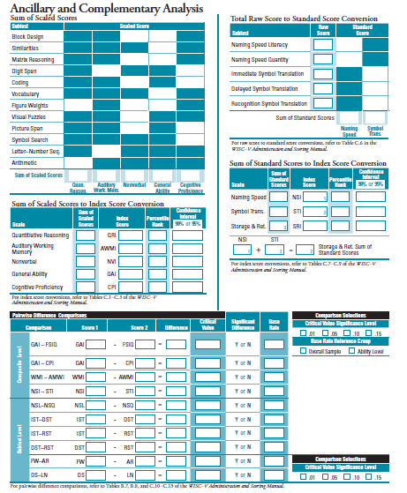
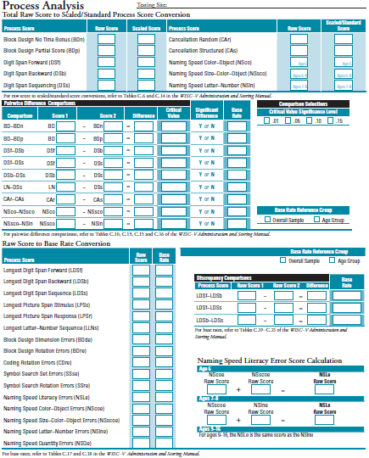
Ancillary and Complementary Analysis Page
(Derive Complementary Subtest Scores & Ancillary & Complementary Index Scores, Do Pairwise Comparisons)
Ancillary Complementary
Process Analysis Page
(Derive Process Scores, Do Pairwise Comparisons)

Slide 32
Deriving Process Scores and Base Rates

Slide 33
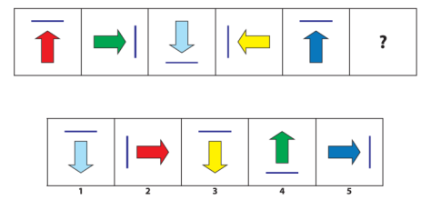
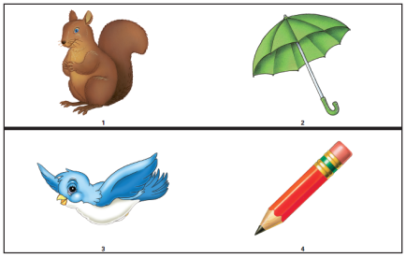
Changes to Retained Visual Spatial and Fluid Reasoning Subtests
Block Design
New diamond and X-shaped designs
Process scores
BDn
BDp
BDde
BDre
Matrix Reasoning
Two item types retained and taught
2x2 matrix
serial order
New items
Picture Concepts
Images not reused
New items
Arithmetic
New items
One repetition on difficult items, none on others
“A band sets up for 25 minutes, plays for 40 minutes, and packs up for 20 minutes. The next band sets up for 20 minutes, plays for 45 minutes, and packs up for 15 minutes. The last band sets up for 20 minutes, plays for 105 minutes, and packs up for 10 minutes. If the first band starts setting up at 6:30, what time is it when the last band finishes packing up?”

Slide 34
Block Design Administration
But first...memorizing the WISC-V (and WPPSI-IV) discontinue rules in 10 seconds or less
Shortened discontinue
Instructions slightly briefer
Frequent admin errors
Presenting blocks wrong (Moon, Blakey, Gorsuch, & Fantuzzo, 1991)
Forgetting to start stopwatch
Rotations
How often are they corrected? When?
Do I give credit if child rotates it to the correct orientation before the time limit would have expired?
Scoring changes...
Notes:
impact of presenting blocks uncorrectly unknown
Correct first rotation at the time limit or when child is finished ONLY.

Slide 35
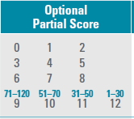
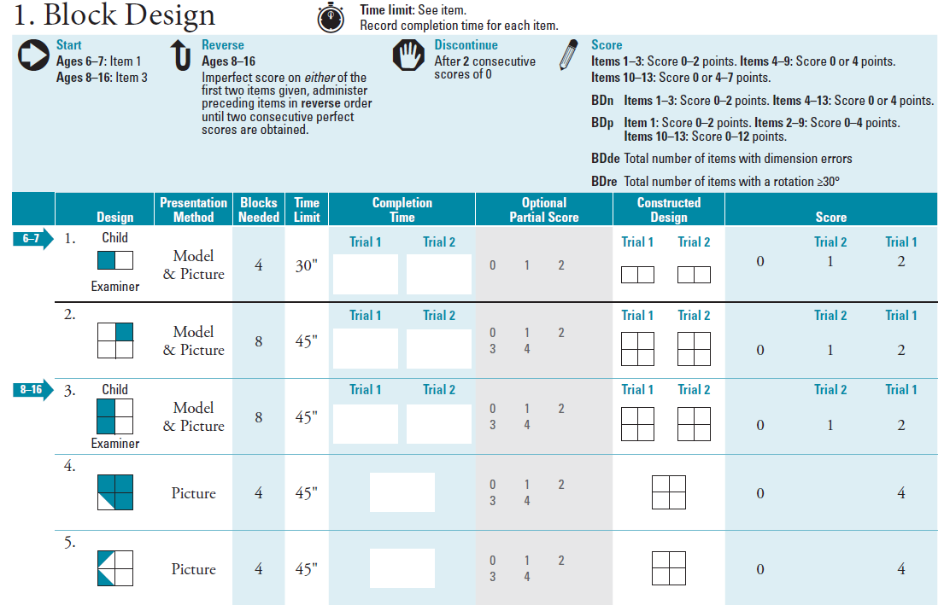
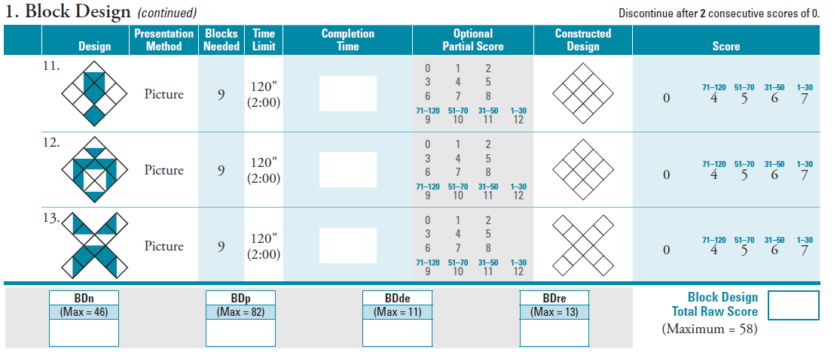
Block Design Scoring
Optional partial score column
Recording new process scores
changing time limit reminder
Notes:
partial score: don’t get confused with main score. Gray and smaller. not on far right.
new process scores:
BDre (at time limit/when done only)
BDde (anytime during assembly)

Slide 36
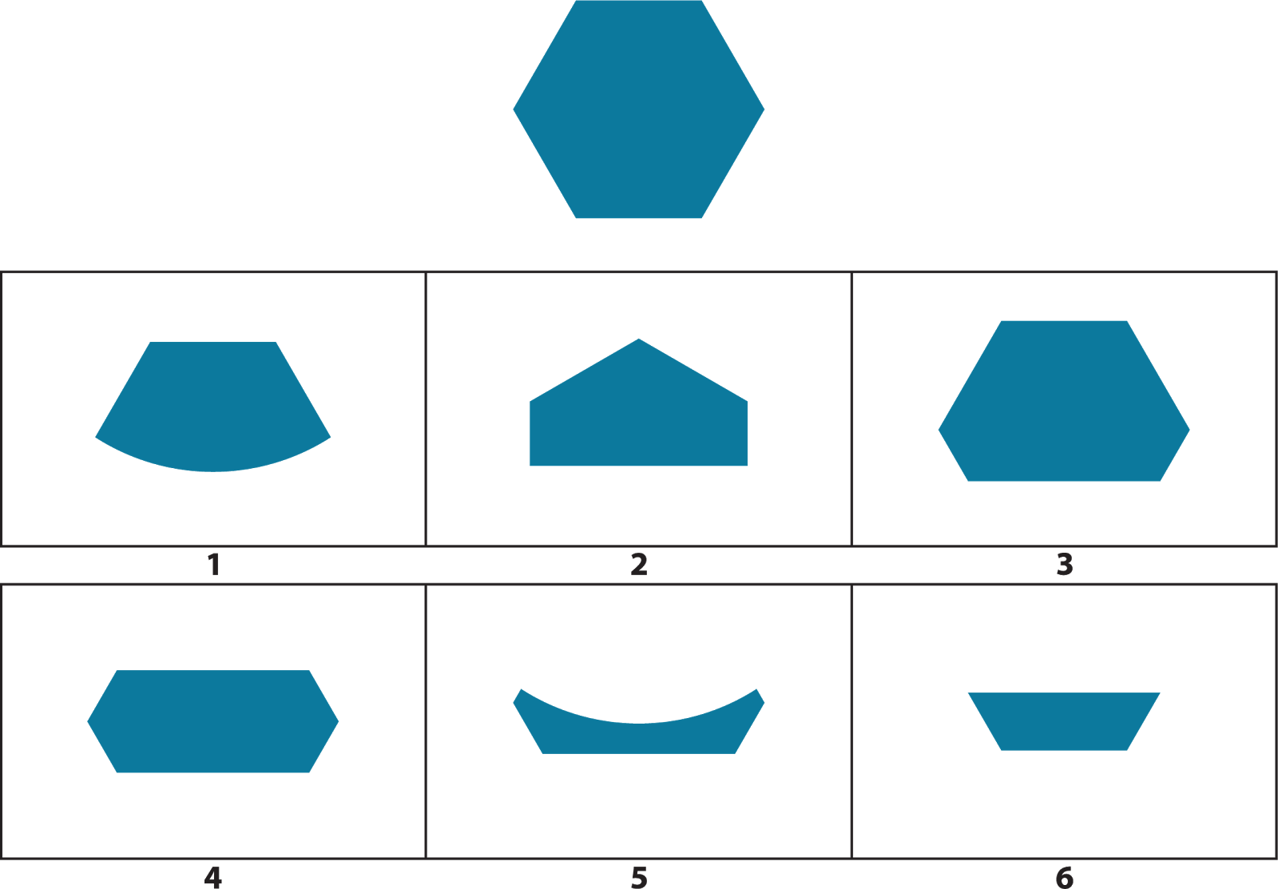
Visual Puzzles Administration
Child views completed puzzle and selects three response options that combine to reconstruct the puzzle
Item time limit of 30 seconds
Measures ability to analyze and synthesize abstract information
“Which three pieces go together to make this puzzle?”
Most common admin error?: ____________________
Notes:
most common admin error: forgetting to ask for three responses

Slide 37
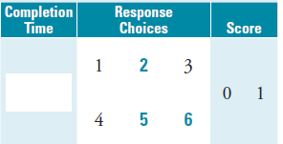
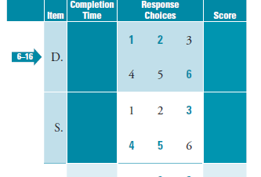
Visual Puzzles Scoring
Common error alert!
circle responses
for later analysis

Slide 38
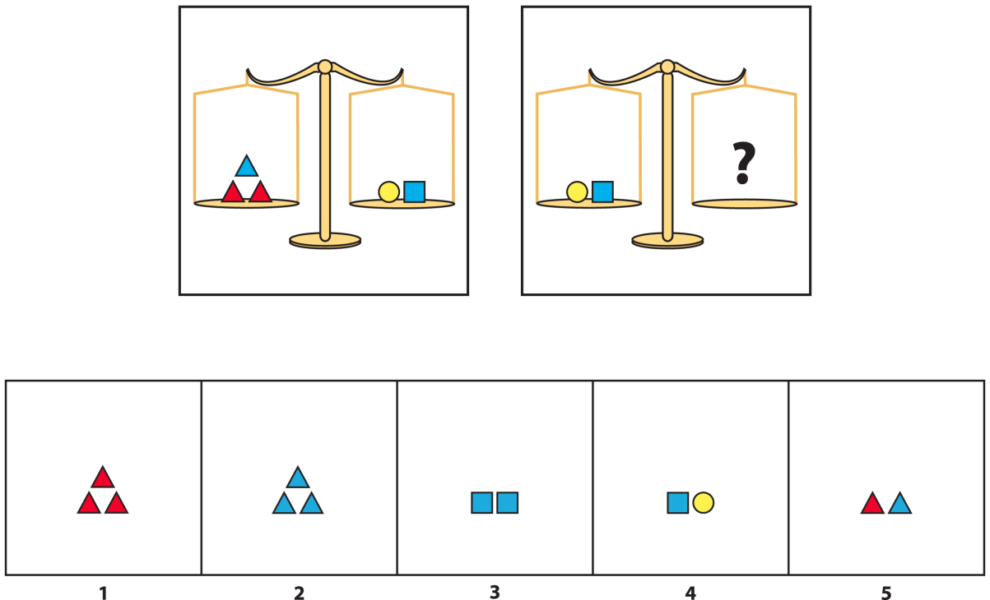
Figure Weights Administration
Child views scale with missing weight(s) and selects the response option that balances the scale
Item time limit of 20 or 30 seconds
Measures quantitative fluid reasoning
“Which one of these weighs the same as this?”
Most frequent admin error?: _______________________

Slide 39
Figure Weights Scoring
changing time limit reminder after item 18
Common error alert!
circle response
Notes:
Time limit varies across subtest (change at item 19)
If starting at sample A, remember to admin sample B after items 1-3 and give instruction
don’t administer SA if you start at item 4 (ages 9-16) and reverse
give verbatim at item 27 where it switches to 3 scales

Slide 40
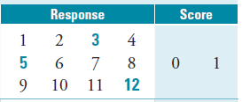
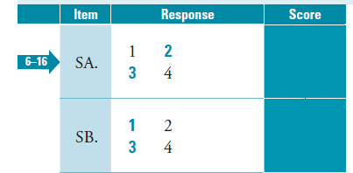
Picture Concepts Administration and Scoring
Common error alert!
circle responses
for later analysis
Picture Concepts lore: “Alternate responses penalize GT and creative children”
Most frequent admin errors?: _________________
Notes:
Process observation: return to missed items and ask for rationale
most frequent admin errors:
forgetting to ask for a response in all rows
strict enforcement of 30 second guideline as a time limit

Slide 41
Arithmetic Administration and Scoring
Cannot repeat: 1-20 (child is told explicitly)
Can repeat: 21-34 (child is told explicitly)
Questions longer, second half
Pause timing if repeating
Process observation ideas...

Slide 42
Verbal Comprehension Subtest Admin and Scoring
But first...did you know? Crackback binder
No significant changes to administration, just sample responses and queries and shorter discontinues
What does “3 consecutive” mean? A. consecutively numbered? or B. consecutively administered?
The saga of a sample response with a query...
Most frequent administration error on Wechsler intelligence protocols among experienced and novice examiners: _____________________________
Second most frequent administration error on Wechsler intelligence protocols: _____________________________
Third most frequent administration error on Verbal Comprehension subtests: _____________________________
Notes:
not querying, should have queried
querying when should not have queried
not recording verbatim responses

Slide 43
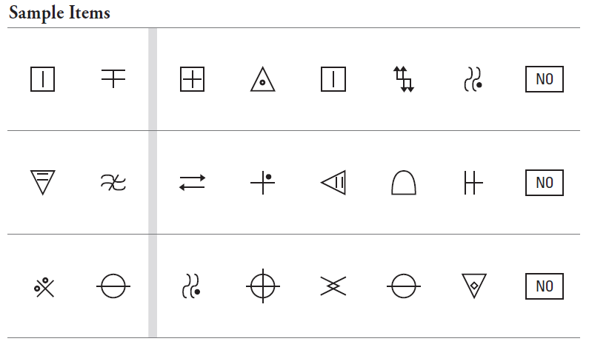
Changes to Retained Processing Speed Subtests
Coding
Item difficulty consistent across rows
Symbols can be written without lifting pencil
Eliminate rotated versions of the same symbol
Rotation errors score
Symbol Search
New symbols
Set and rotation error scores
Cancellation
New art
Designed by quadrant (target to distracter ratio)

Slide 44
Changes to Retained Working Memory Subtests
Digit Span
Added trial to Forward ceiling
Added some trials for gradient
Added new Sequencing task
Letter-Number Sequencing
Teaching modified for floor
Notes:
Teach Number then letters first.
Next, add sequencing element.
Reduces incidence of children who repeat the letters in order before reordering the numbers (and the subsequent customer service questions and need for an FAQ).

Slide 45
Changes to Retained
Verbal Comprehension Subtests
Similarities
Vocabulary
Information
Comprehension
Revised scoring rules with data-based queries
Reviewed vocabulary level (no more “advantages”)
New, contemporary item content
Updated art with increased international portability
*“Why do people use passwords?”
*all items and item images are fake to protect the innocent
Notes:
Hobbit
Scientist-Detective
Passwords
Candy in schools

Slide 46
Subtest Reliability (good to excellent)
Subtest | Internal Consistency Reliability
Similarities | .87
Vocabulary | .87
Information | .86
Comprehension | .83
Block Design | .84
Visual Puzzles | .89
Matrix Reasoning | .87
Figure Weights | .94
Picture Concepts | .83
Arithmetic | .90
Digit Span | .91
Picture Span | .85
Letter-Number Sequencing | .86
Coding* | .82
Symbol Search* | .81
Cancellation* | .82
Naming Speed Literacy* | .86
Naming Speed Quantity* | .83
Immediate Symbol Translation* | .88
Delayed Symbol Translation* | .87
Recognition Symbol Translation | .82
*= test-retest stability (split half would artificially inflate reliability estimate)

Slide 47
Composite Score Reliability (excellent)
Composite Score | Internal Consistency Reliability
VCI | .92
VSI | .92
FRI | .93
WMI | .92
PSI* | .88
FSIQ | .96
QRI | .95
AWMI | .93
NVI | .95
GAI | .96
CPI | .93
NSI* | .90
STI | .94
SRI | .94
*= test-retest stability

